Slide 1


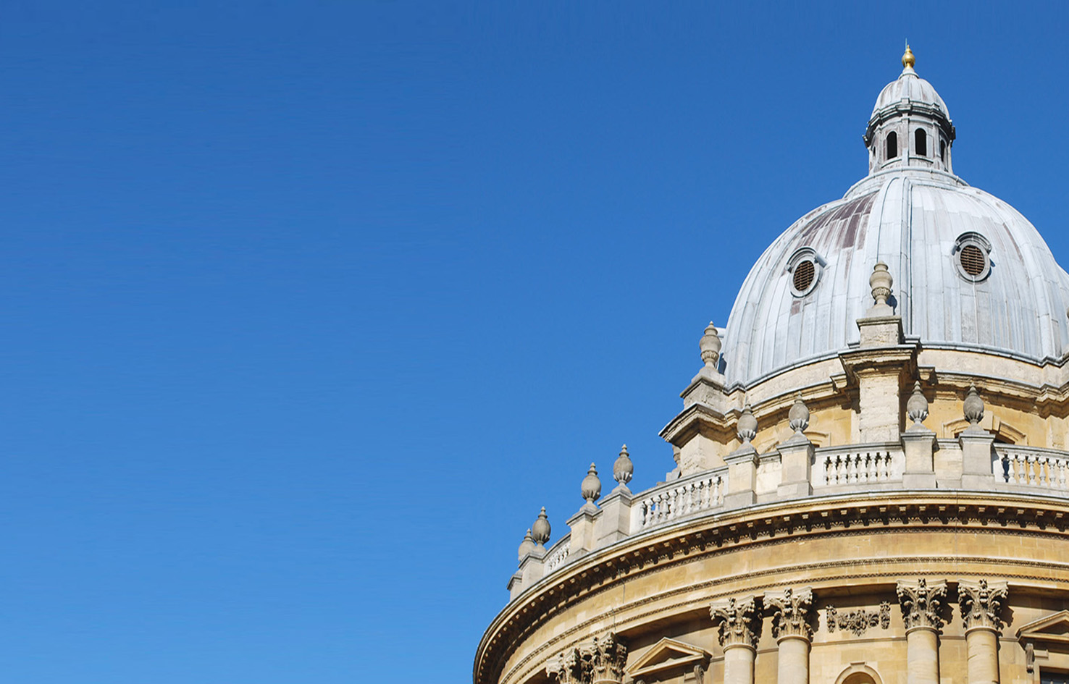


An Opensource Framework to Analyse Marker-based and Inertial-Sensor-based Motion Measurements: Motion Capture Analysis & Plotting Assistant (MCAPA) 2.0
Runbei Cheng^{1*}, Vikranth H. Nagaraja¹, Jeroen H. Bergmann¹, and Mark S. Thompson²
*runbei.cheng@wadham.ox.ac.uk
¹Natural Interactions Lab,
Department of Engineering
University of Oxford,
Oxford – OX1 3PJ
²Oxford Mechanobiology Group,
Institute of Biomedical Engineering,
University of Oxford,
Oxford – OX3 7DQ
02/09/2019
Notes:
Hello everyone, welcome to the final presentation of this event. I am Vikranth, and I am reading for a D.Phil. in Biomedical Engineering at the University of Oxford. Today, I’ll be taking you through this talk on ‘Compensatory Movements Involved During Simulated Upper Limb Prosthetic Usage: Reach Task vs. Reach-to-Grasp Task.’

Slide 2
Introduction
3D-printed prosthetics offer enhanced personalisation, affordability, and accessibility; however, evidence on their clinical-efficacy and effectiveness is lacking (Diment et al. 2017)
Need to evaluate functional performance in the final end-user’s setting, especially for affordable prostheses and/or in a resource-constrained setting
Functional outcome measures for prostheses:
Subjective measures (based on patient’s feedback, or clinician’s report and surveys)
Objective measures (data generated using validated equipment & standardised measurement protocols)
Most objective tests assessing prosthetic skill are time-based – (e.g. SHAP test, Box and Blocks test)
No information on the quality of movement or the upper extremity (UE) movement patterns spatiotemporally
Motion capture (MoCap) based kinematic analysis could be a powerful complement to standardized and objective outcome measures (Heckathorne & Stine 2011; Kyberd et al. 2009)
Unfortunately, marker based MoCap systems (considered to be the ‘gold standard’) are generally not available in low-resource settings
2 of 10

Slide 3
Introduction (Continued)
Inertial sensor based MoCap systems → portable and less costly; viable alternative to marker based MoCap systems (Zhou & Hu 2008; Nagaraja et al. 2019).
Analysis of MoCap data requires coding skills in computing languages that an average clinician might be unfamiliar with.
Opensource applications and libraries → for marker based MoCap data, e.g., MoKKa, Biomechanical ToolKit, biomechZoo, GaitViewer, C3Dserver, MOtoNMS, pyCGM, etc.
Motion Capture Analysis & Plotting Assistant (MCAPA)¹ developed to offer an opensource framework for post-processing, visualisation, and interpretation of inertial-sensor-based MoCap data for user-friendly analyses¹ (especially in the field of prosthetic arms) (Cheng et al. 2019).
Objective: The current study presents an updated version of MCAPA, i.e. MCAPA v2.0 that incorporates *.C3D data compatibility, in hope of standardising testing methods.
(Note: The C3D format is a public domain, binary file format that is used in Biomechanics, Animation, and Gait Analysis laboratories to record synchronised 3D and analog data.)
3 of 10

Slide 4
Methods
MCAPA 2.0 (https://github.com/runbei/mcapa) is coded in MATLAB® R2018a and compiled as a standalone executable application powered by MATLAB® Runtime.
Following MoCap for a selected functional task execution using a full-body Xsens system via MVN Analyze 2018 software, this data is exported as a *.MVNX file.
Similarly, after concurrent MoCap for the same functional task execution using a full-body Plug-in Gait marker (PGM) protocol via Vicon Nexus™ 2.8 software, this data is exported as a *.C3D file.
Both filetypes (i.e. *.MVNX and *.C3D) are compatible with our latest version of the app. (*.C3D support through Functions from Biomechanical Toolkit (BTk) library (Barre & Armand 2014))
Joint angles provided by the MVN biomechanical model are calculated per Z-X-Y Euler angle sequence following ISB guidelines (Wu et al. 2005) which can be analysed using MCAPA, facilitating an array of qualitative and quantitative assessments.
PGM model (Vicon Plug-in Gait 2010) provides joint angle outputs based on a proprietary model that does not follow ISB Guidelines².
However, this package helps establish equivalence in the joint coordinate system (JCS) between the two models and converts the PGM outputs to match the Euler sequence followed by the Xsens MVN model and consequently the ISB Guidelines.
4 of 10
Notes:
Wrist brace was used to mimic lack of a controllable wrist in a typical prosthetic device; Talk about reduction in DoF
RF task involves… where as RGF task involves…

Slide 5
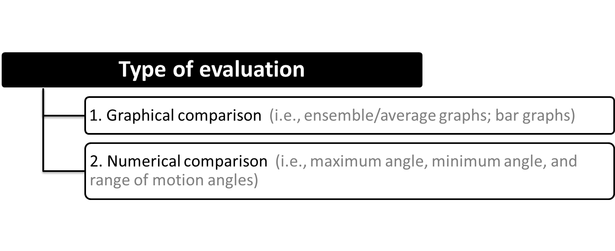
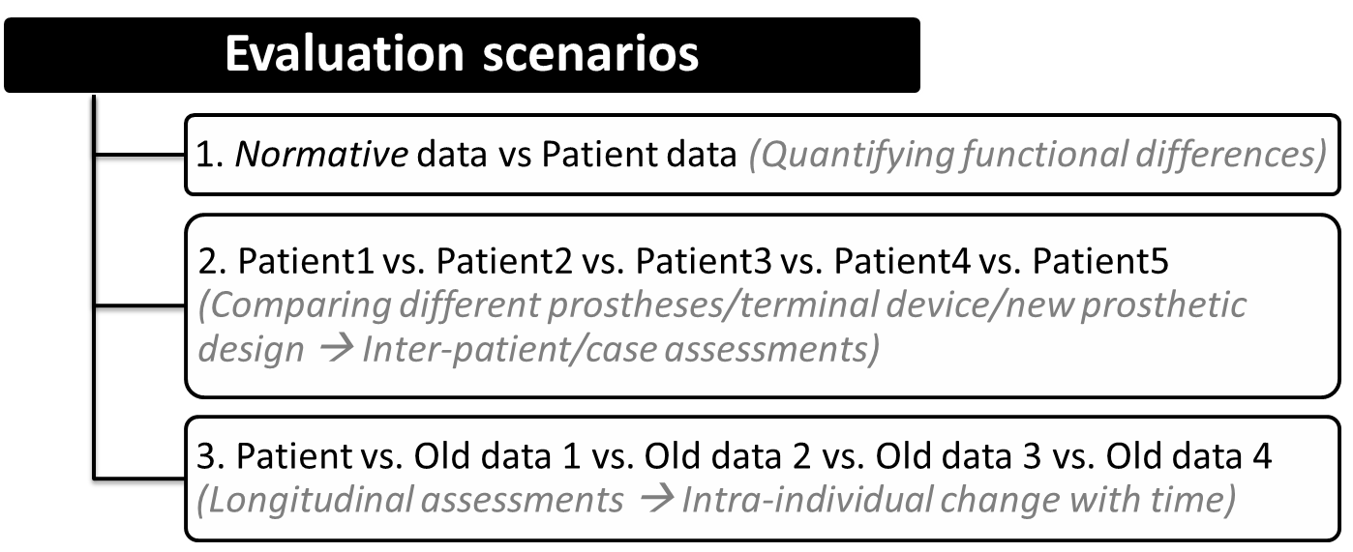
Motion Capture Analysis & Plotting Assistant 2.0
5 of 10
Notes:
Wrist brace was used to mimic lack of a controllable wrist in a typical prosthetic device; Talk about reduction in DoF
RF task involves… where as RGF task involves…

Slide 6
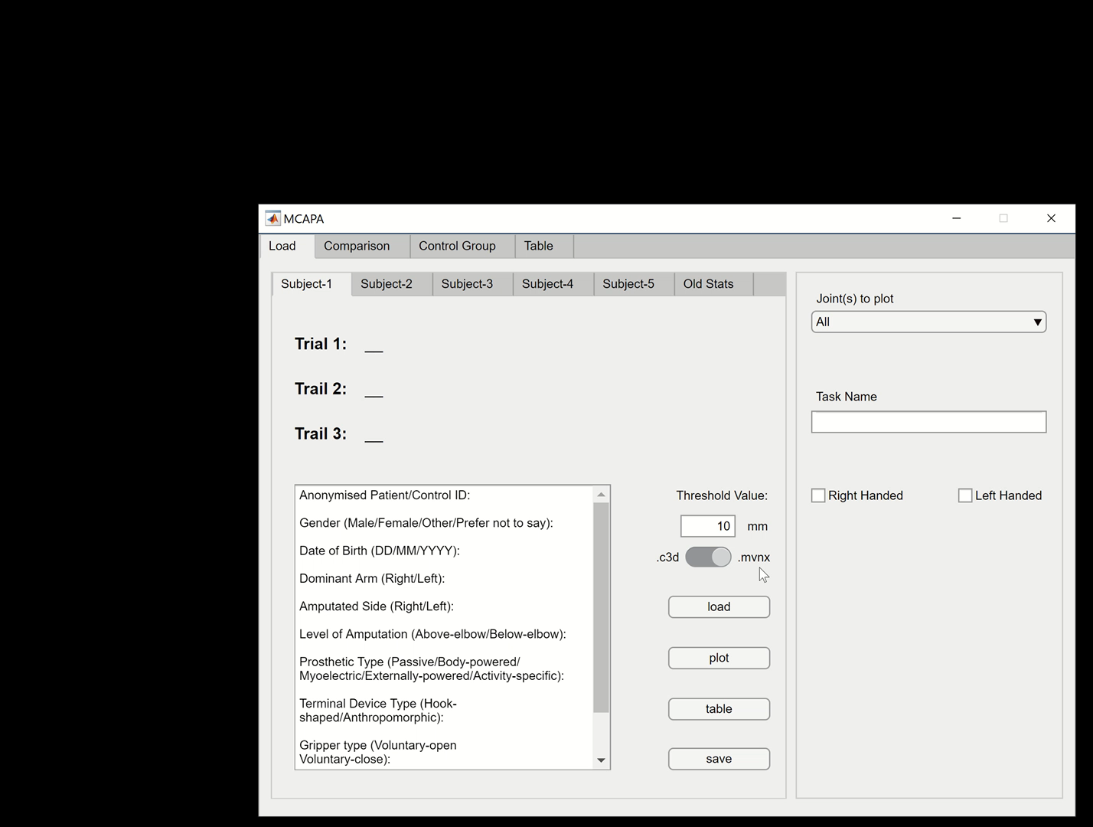
MCAPA 2.0 App -- Video Demo
6 of 10

Slide 7
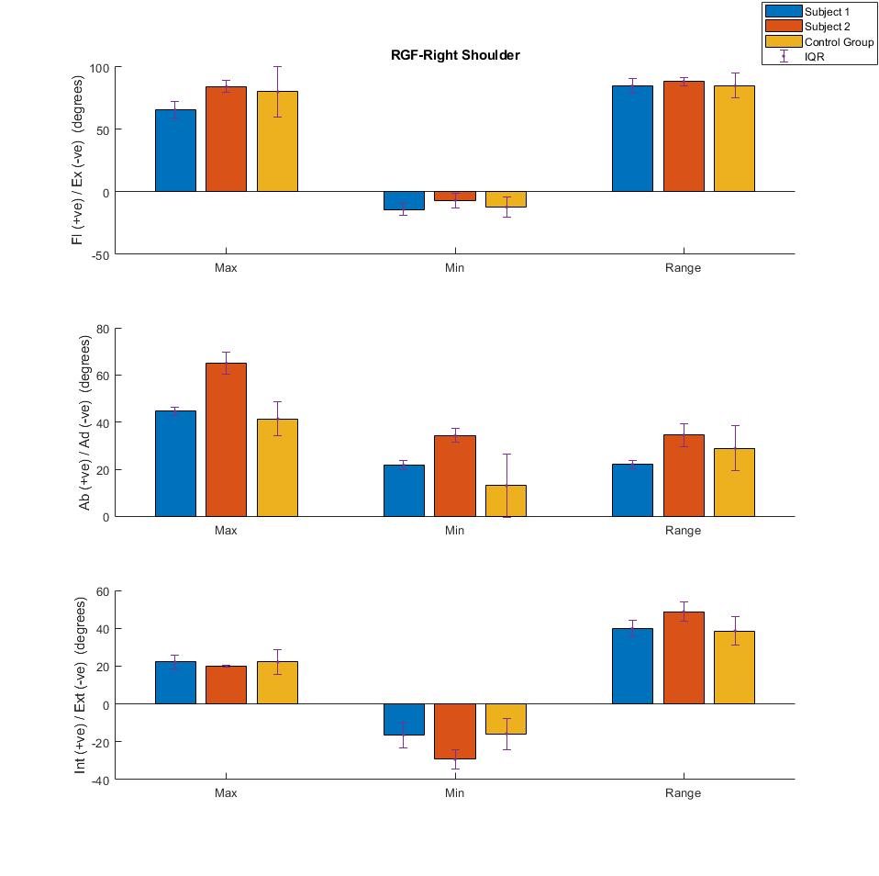
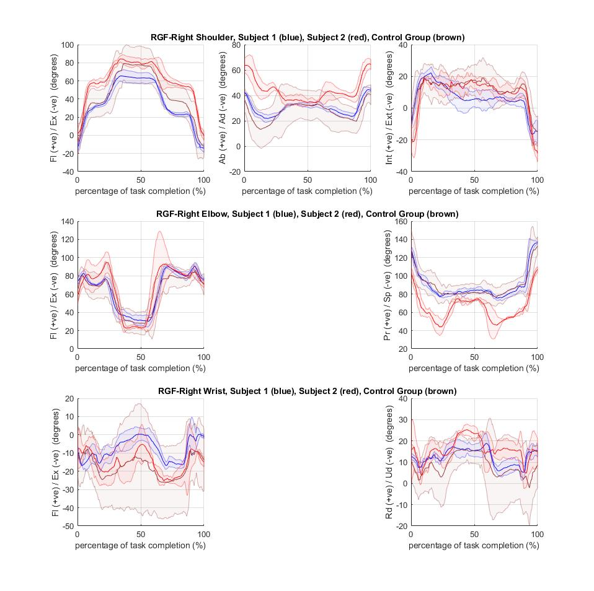
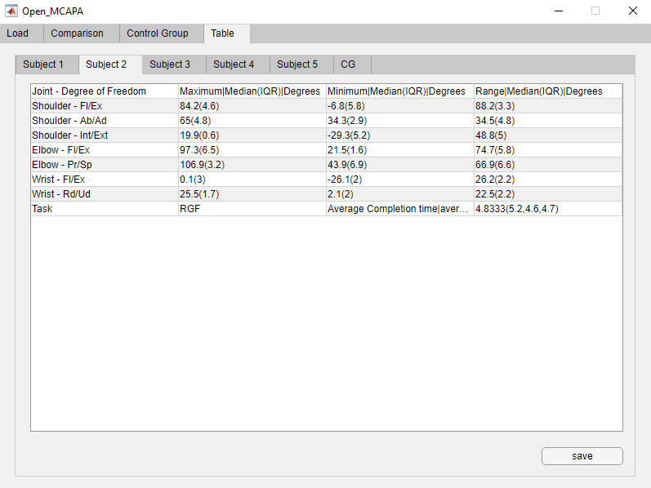
Results
Numerical comparison (e.g. maximum angles, minimum angles, joint range of motion, figure 3.), and
Graphical comparison (e.g. movement range bar graphs, figure 4; ensemble graphs, figure 5;)
The app is customisable to match requirements for different research questions.
Can provide different model (PGM and MVN) outputs at kinematic level.
Figure 5: Joint Angle Plots
Figure 3: Max/Min/Range Joint Angle Table
Figure 4: Max/Min/Range Joint Angle Bar Plot
7 of 10

Slide 8
Discussion
MCAPA v2.0 eliminates the need for coding, making movement analyses more feasible for clinicians and researchers alike.
Potential to improve objectivity in treatment planning and clinical decision-making
A move towards standardisation in UE biomechanical studies (Wu et al., 2005; Rau et al., 2000; Anglin & Wyss, 2000)
Opensource app; adaptability to different research questions/objectives
8 of 10
Notes:
ISB standards will lead to better communication among researchers and clinicians.

Slide 9
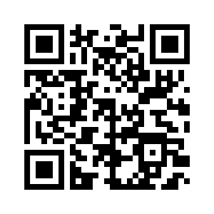
Future work
Making the app compatible with lower-extremity data for gait analysis
Improving accessibility features (e.g. plot colour; greyscale)
Usability testing → Further improving the user interface
Scan this code for the GitHub link for the app and a copy of the slides
9 of 10

Slide 10



Thank you!
Questions
Acknowledgements:
Natural Interactions Lab, Oxford Mechanobiology Group, Oxford Centre for Enablement, Opcare, and Oxford Gait Laboratory
Support from: the Wellcome Trust grant number 103383/B/13/Z, and the EPSRC Impact Acceleration Account Award EP/R511742/1

Slide 11
References
Anglin C, Wyss U. 2000. Review of arm motion analyses. Proceedings of the Institution of Mechanical Engineers, Part H: Journal of Engineering in Medicine. 214:541-555.
Barre A, Armand S. 2014. Biomechanical ToolKit: Open-source framework to visualize and process biomechanical data. Computer Methods and Programs in Biomedicine. 114:80-87.
Cheng R, Nagaraja V, Bergmann J, and Thompson M. 2019. Motion Capture Analysis & Plotting Assistant: An Opensource Framework to Analyse Inertial-Sensor-based Measurements. Trent International Prosthetic Symposium - 2019 (TIPS'19), UK.
Diment L, Thompson M, Bergmann J. 2017. Three-dimensional printed upper-limb prostheses lack randomised controlled trials: A systematic review. Prosthetics and Orthotics International. 030936461770480.
Heckathorne C, Stine R. 2011. Using motion analysis to augment upper-limb prosthetics outcome measures. “Mec’11 Raising the Standard.” In Proceedings of the 2011 MyoElectric Controls/Powered Prosthetics Symposium. New Brunswick, Canada.
Kyberd P, Murgia A, Gasson M, et al. 2009. Case studies to demonstrate the range of applications of the Southampton Hand Assessment Procedure. British Journal of Occupational Therapy. 72:212-218.
Nagaraja V, Cheng R, Kwong E, Bergmann J, Andersen M, and Thompson M. 2019. Marker-based vs Inertial-based Motion Capture: Musculoskeletal Modelling of Upper Extremity Kinetics. Trent International Prosthetic Symposium - 2019 (TIPS'19), UK.
Rau G, Disselhorst-Klug C, Schmidt R. 2000. Movement biomechanics goes upwards: From the leg to the arm. Journal of Biomechanics. 33:1207-1216.
Vicon Plug-in Gait. 2010 [Internet] [last accessed 2019 August 25]. Available from: http://vicon.com/downloads.
Wu G, et al. 2005. ISB recommendation on definitions of joint coordinate systems of various joints for the reporting of human joint motion—Part II: Shoulder, elbow, wrist and hand. Journal of Biomechanics. 38:981-992.
Zhou H, Hu H. 2008. Human motion tracking for rehabilitation - A survey. Biomedical Signal Processing and Control. 3:1-18.

Slide 12
Back-up slides

Slide 13
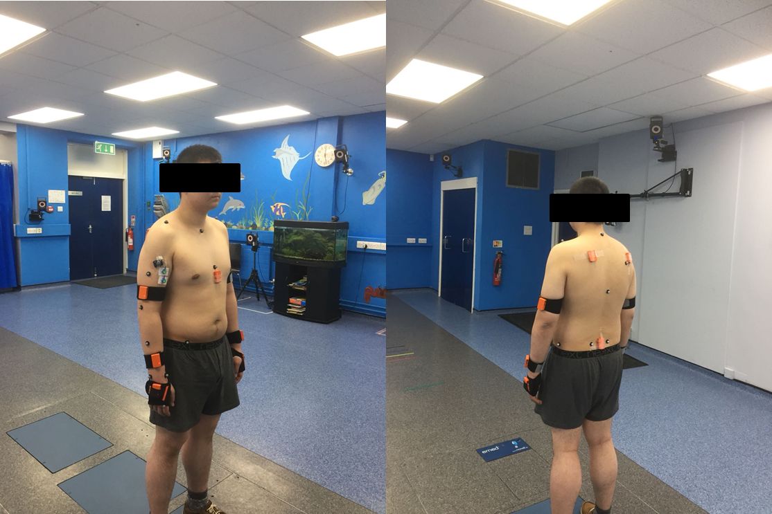
Data capture
Description | Marker-based Mocap (‘Gold standard’) | Inertial-sensor-based Mocap
Equipment | 16-Camera Vicon™ T40S Series System (Vicon Motion Systems, Oxford, UK) | Xsens MVN Awinda Station (Xsens Technologies, Enschede, Netherlands)
Software# (Data acquisition & Pre-processing) | Vicon Nexus™ v2.8 (Vicon Nexus 2.8 Manual 2018) | Xsens MVN Analyze 2018 (Xsens MVN User Manual 2017)
Protocol | Plug-in Gait marker protocol (Vicon Plug-in Gait 2010) Passive markers: 42 for Full-body; 27 for RH-/LH-body (+3 markers for Grasp object) | Full-body MVN Awinda sensor system (Xsens MVN User Manual 2017) 17 MTw wireless sensors (+1 prop sensor for Grasp object)
Data type | *.C3D | *.BVH
Sampling frequency | 100 Hz | 60 Hz
#Data capture with Xsens as a ‘master’ triggering the Vicon Workstation to synchronise data capture

Slide 14
Data analysis
Data pre-processing:
Threshold Analysis: Identifying start and end frames for each trial
Signal conditioning: 4th Order, Zero-lag, Butterworth filter with a cut-off frequency of 6 Hz (Winter 2009)
Personalised musculoskeletal modelling:
AnyBody™ Modeling System v.7.1.2 (AnyBody™ Technology A/S, Aalborg, Denmark)
AnyBody Managed Model Repository v.2.1.1
Default 3rd Order Polynomial muscle recruitment criterion
Marker-based mocap data: Simple Full-Body model
Inertial-sensor-based mocap data: Inertial MoCap model
Model-estimated outputs for UE:
Kinematic outputs – Joint angles
Kinetic outputs – Joint reaction forces, Joint moments, and Muscle forces
Statistical analysis
Data reduction techniques, statistical analyses, and comparison of outputs → MATLAB® R2016b (Mathworks Inc., Massachusetts, USA)
Jarque-Bera test (Jarque & Bera 1980) to verify normality; Statistical significance p < 0.05
Qualitative comparison: Ensemble/averaged median (IQR) plots
Quantitative comparison: RMS differences, Boxplots, and Spearman's rank correlation coefficient (Categorised “weak” (ρ ≤ 0.35), “moderate” (0.35 < ρ ≤ 0.67), “strong” (0.67 < ρ ≤ 0.90), and “excellent” (ρ > 0.90))

Slide 15
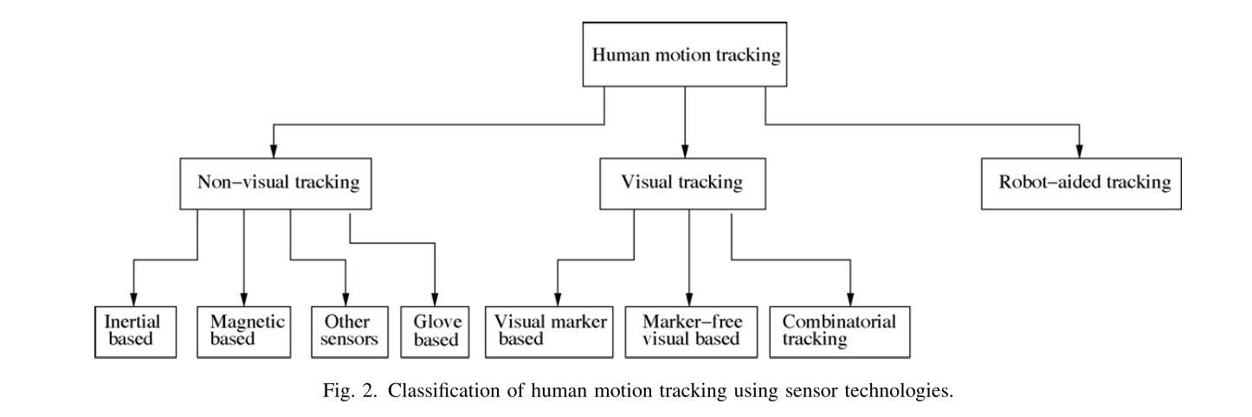
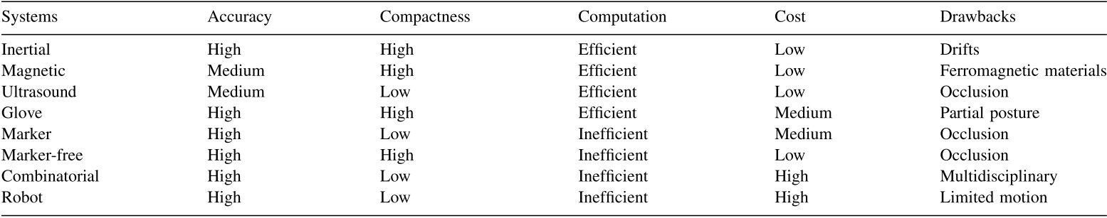
Classification of human motion tracking using sensor technologies
(Zhou & Hu 2008)

Slide 16
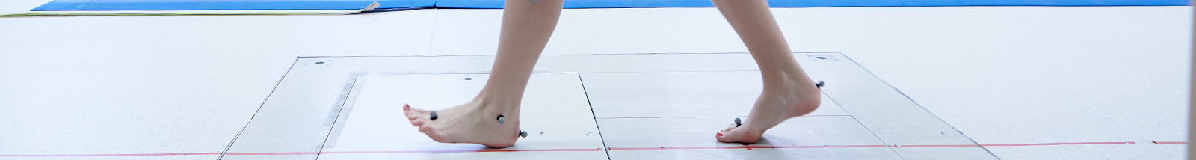
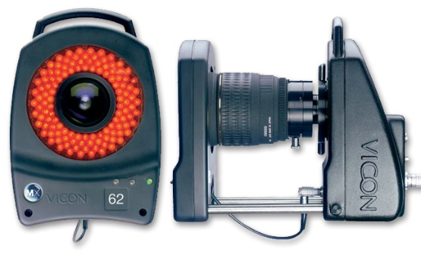
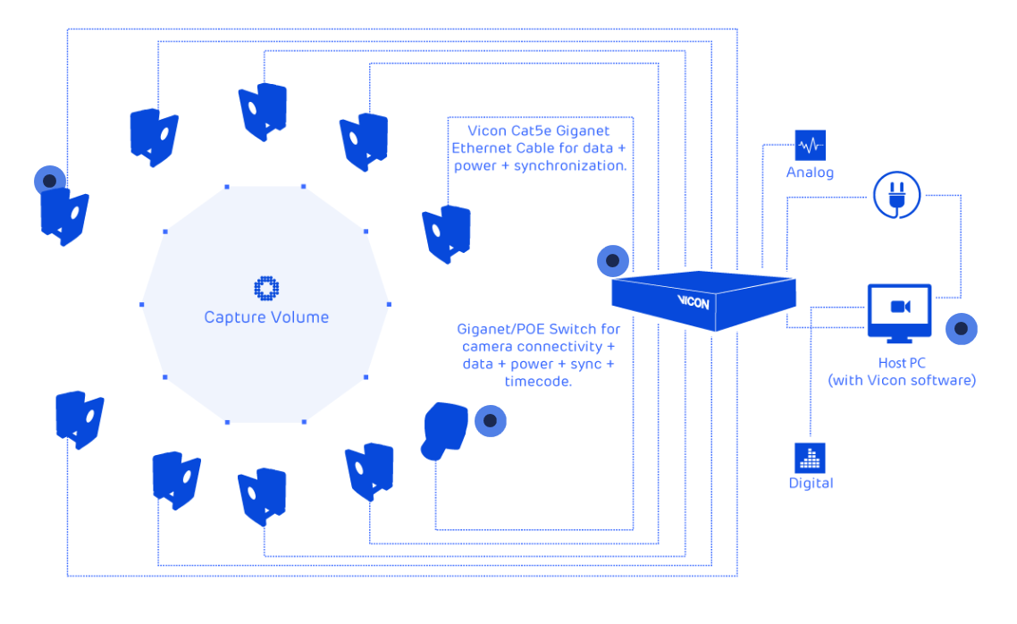
Marker-based motion capture
Images from Vicon

Slide 17
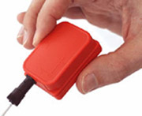
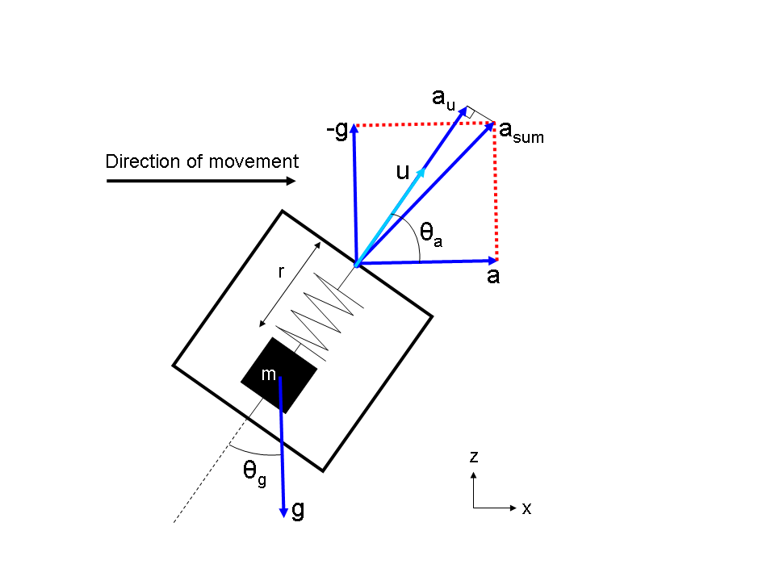
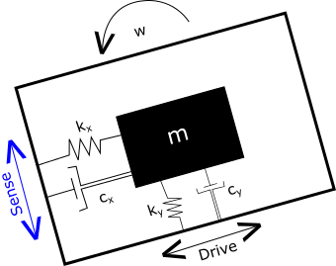
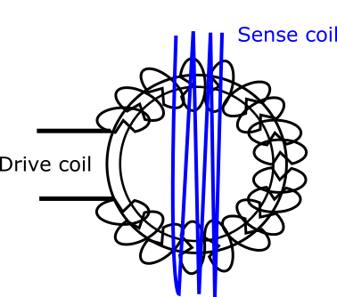
Inertial Sensors – Background
z
y
x
Accelerometers
z
y
x
Kalman filter
R_{dcm}
A₁₁ A₁₂ A₁₃
A₂₁ A₂₂ A₂₃
A₃₁ A₃₂ A₃₃
z
y
Gyroscopes
x
Magnetometers
Images from Xsens
Notes:
An IMU comprises of accelerometers, gyroscopes, and magnetometers combined with a fusion algorithm, e.g., a Kalman filter.

Slide 18
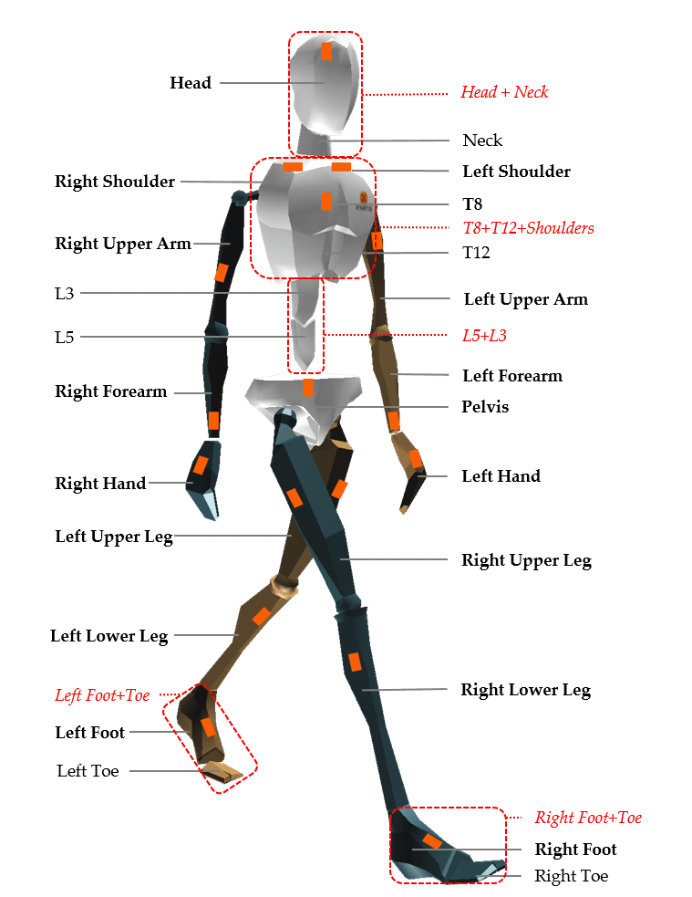
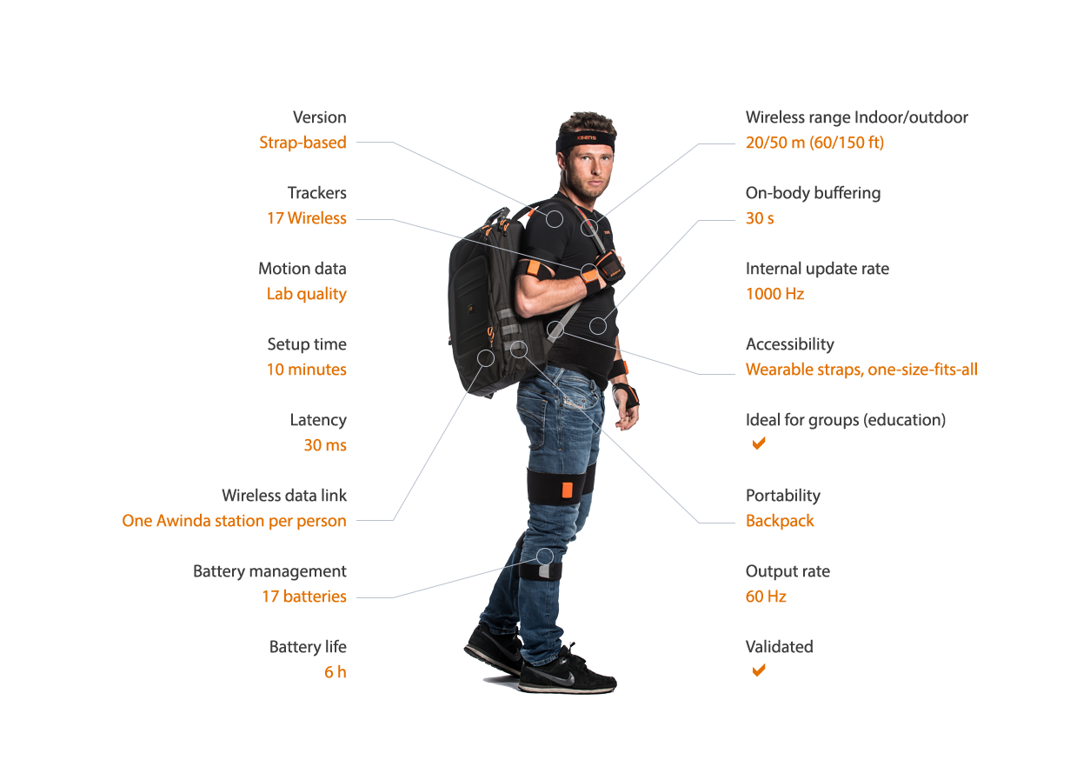
Inertial-sensor details
Images from Xsens
Notes:
It can be attached to a body segment to estimate the movement of that segment in space; and when combined with other IMUs on adjacent body segments, the kinematics of movements can be calculated.
IMU motion-capture systems are portable and less expensive than traditional camera-based motion-capture systems.

Slide 19
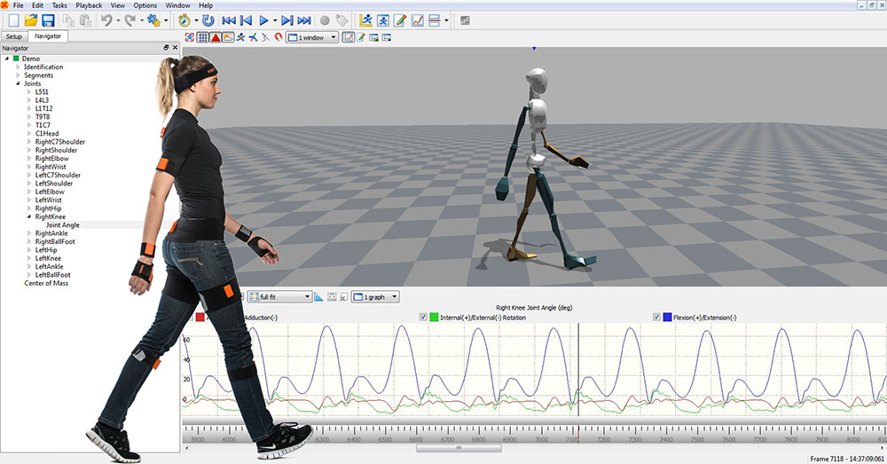
Xsens MVN Analyze software
Images from Xsens

Slide 20
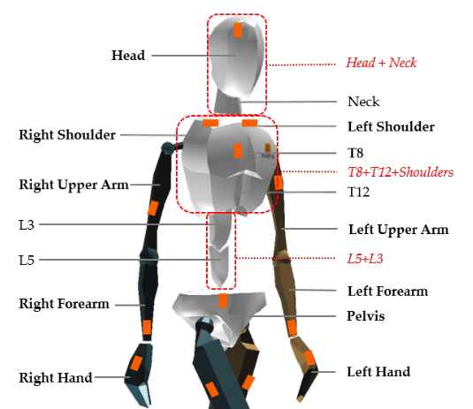
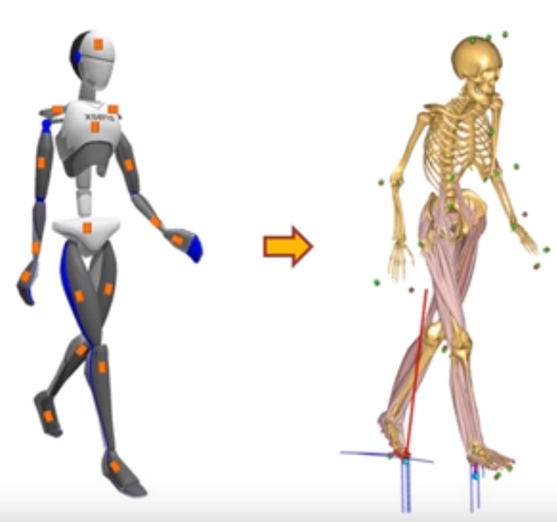
Xsens MVN Analyze software
Images from Xsens/AnyBody

